Slide 1
Climate Projections for the National Capital Region
Presentation of the results
Board of Directors, June 25, 2020

Slide 2
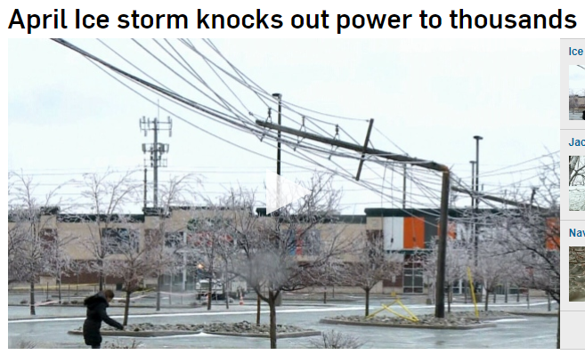
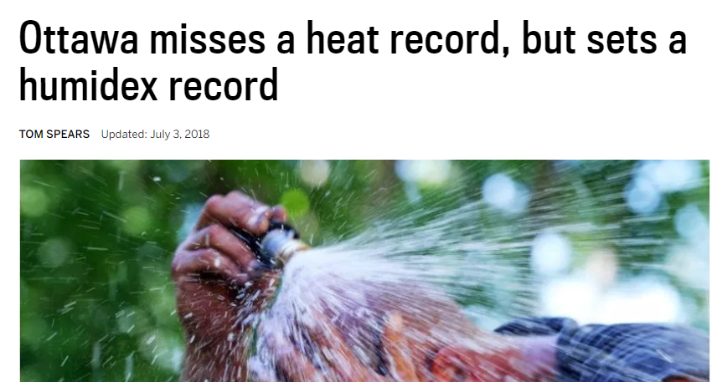
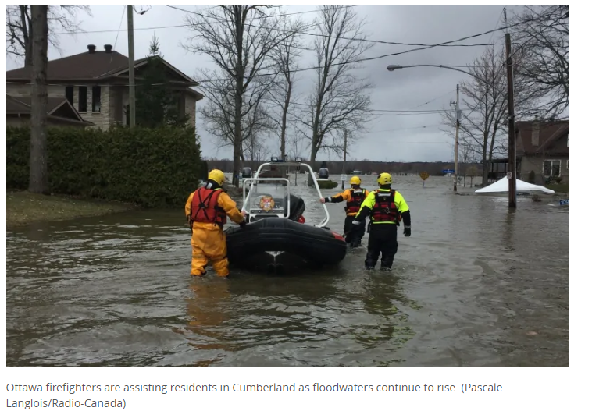
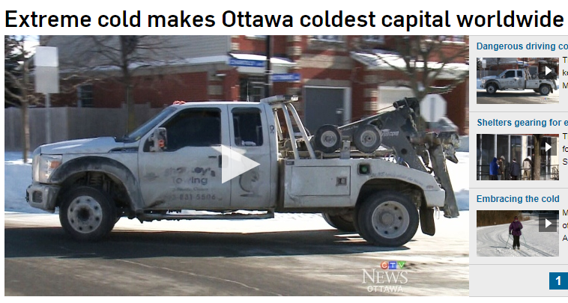
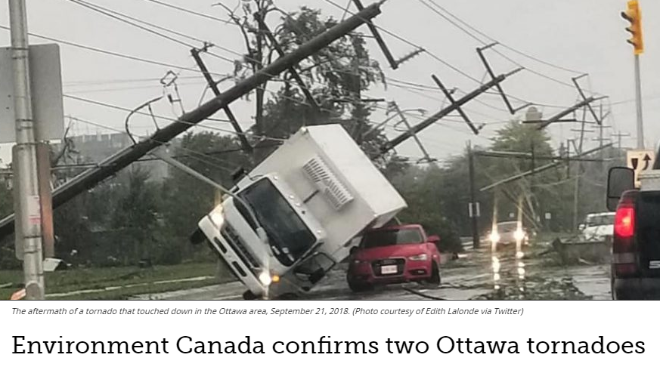
Notes:
.

Slide 3
What spurred this project?
Need a regionally consistent source of data to support adaptation planning
Need advice about indices required
Discuss how to understand and manage data uncertainty

Slide 4
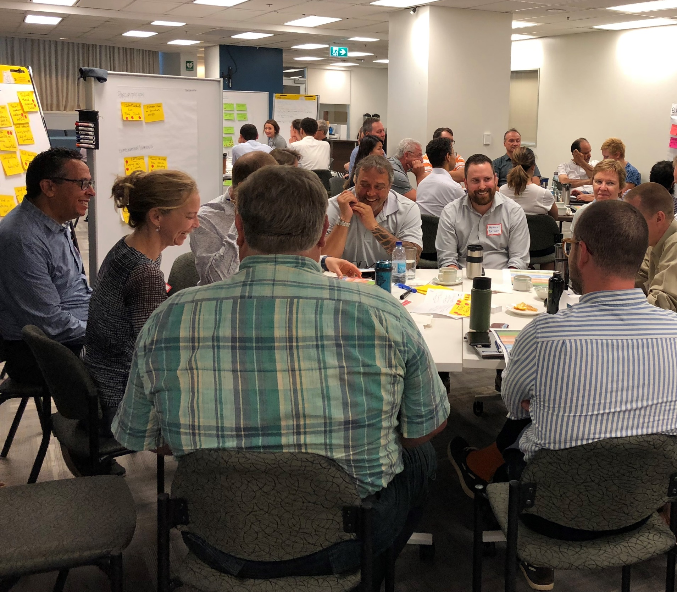
A Collaborative Effort
City of Ottawa
Environment and Climate Change Canada’s Canadian Centre for Climate Services
CBCL Limited

Slide 5
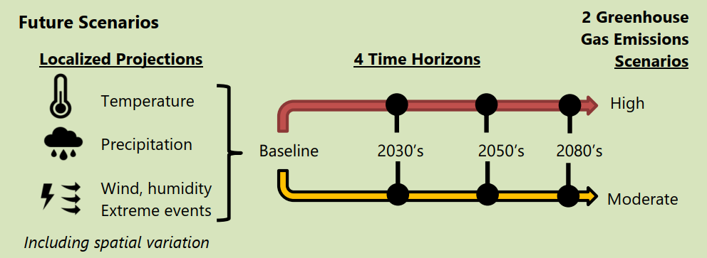
Future Scenarios and Time Horizons

Slide 6
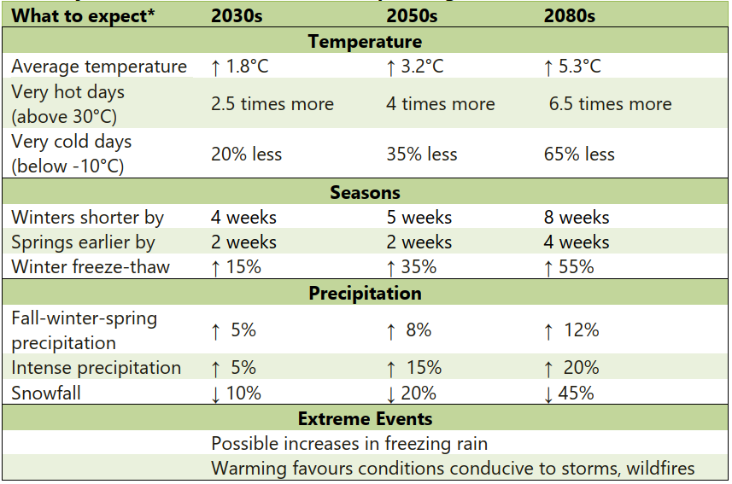

Slide 7
Events/phenomena not (well) captured by models
Freezing rain and ice storms
Extreme snow and blizzards
Extreme wind and gusts
Tornadoes
Hurricanes
Lightning
Evapotranspiration, drought, and wildfire
Air quality
Acid rain
Shortwave radiation

Slide 8
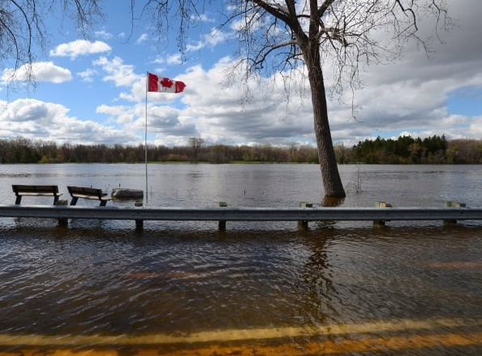
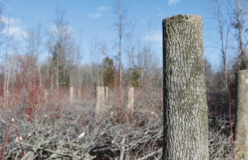
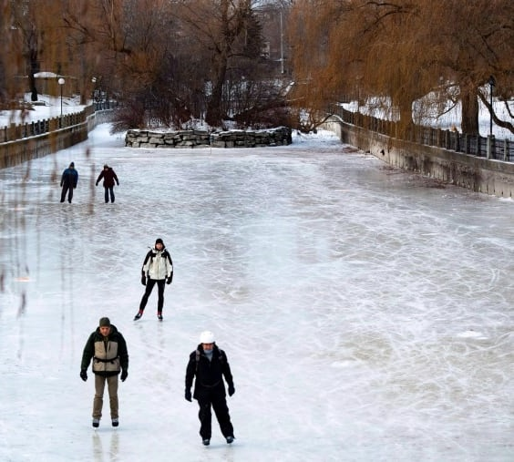
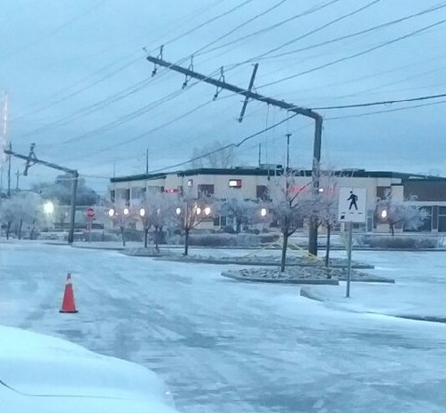
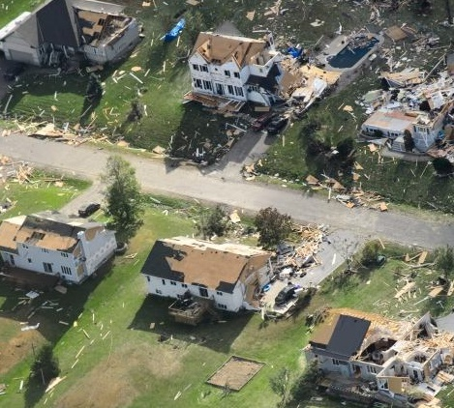
Prominent Climate Impacts on Key Sectors
Health and safety
Water services
Buildings, real estate and planning
Transportation
Natural assets, tourism and recreation
Riverine flooding

Slide 9
Next Steps
Phase 1
Develop climate projections
Phase 2
Evaluate risk and vulnerability
Phase 3
Adaptation and resiliency planning

