Slide 1
Zibi Site – Tesasini Park
Site Zibi – parc Tesasini
Developed Design (FLUDA)
Conception détaillée (AFUSD)
2021/04/22
Board of Directors Meeting
Rencontre du conseil d’administration
2021/04/22
Notes:
Kalen’s Speaking Notes:
Bonjour! / Good morning!
Le premier item à l’ordre du jour ce matin est la conception détaillée du parc Tesasini, une propriété de la CCN située à Gatineau sur la berge nord de la rivière des Outaouais, près du projet Zibi et du pont des Chaudières.
La conception de ce parc et des deux autres parcs sur le site a été présentée au CCUDI en février 2020 et a reçu un appui important des membres du comité.
Le premier parc, Pangishimo, a ensuite été approuvé par le conseil en avril 2020.
Je vais maintenant céder la parole à Jason Hutchison, chef des Approbations fédérales de design, pour nous présenter le contexte et la conception du projet.
Merci pour votre écoute! Thank you!
Jason’s Speaking Notes:
Thank you Kalen, good morning to the Chair and the Board. Next slide please.

Slide 2
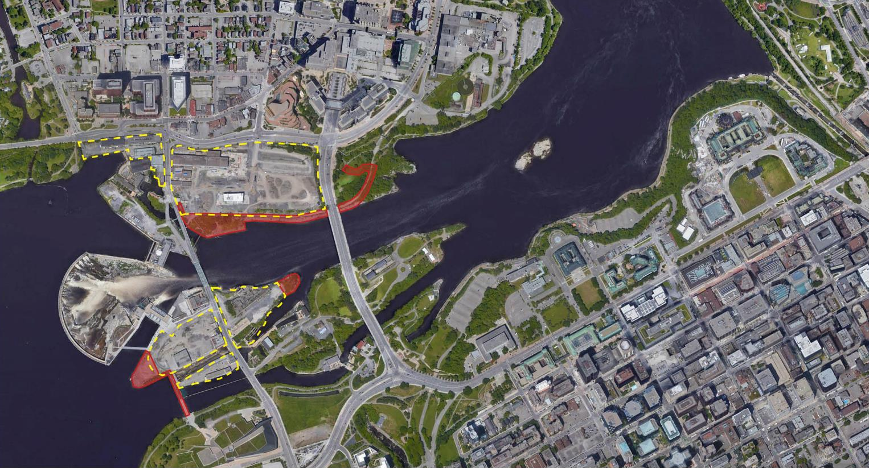
Parliament Hill
Colline du Parlement
Parc Tesasini Park
Parc Mòkaham Park
Parc Pangishimo Park
Notes:
I would like to begin by providing a brief refresher on the history of this project. The area shown on this screen, specifically the Islands and adjacent Ottawa River shoreline has long been identified in NCC plans as lands that should contribute to the Capital function.
This arial photo shows Parliament Hill to the right with the Zibi development outlined in yellow and the proposed NCC park and improvements in red.
Next slide

Slide 3
Built / construit
In development / en développement
Heritage / patrimoine
Future / futur
Notes:
Zooming in a little further, what you see is the proposed Zibi development with the already built and under development buildings in blue and future buildings marked in pink. The NCC owned parks and improvements are shaded in red.
In January 2015, the NCC granted land use and concept approval for the Zibi development. In April of 2018, the NCC and Zibi closed an agreement whereby the NCC would receive 3 new public parks to be constructed by Zibi.
Next slide

Slide 4
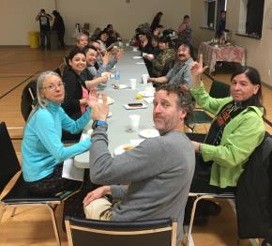
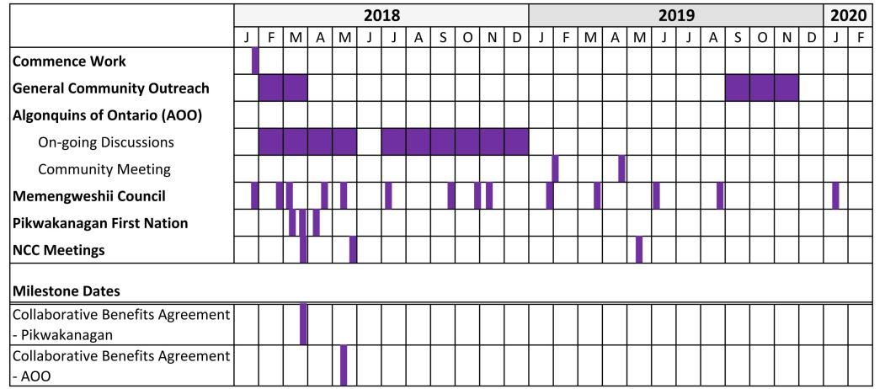
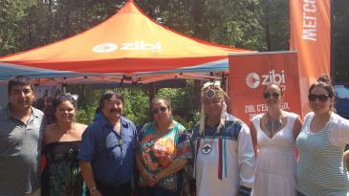
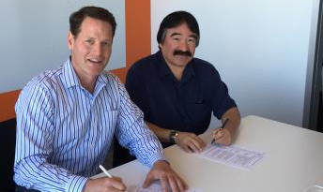
Engagement / Engagement
Notes:
The design of the parks began in collaboration with several stakeholders including the City of Ottawa, la Ville de Gatineau and Energy Ottawa.
Especially significant for the design of the parks was the engagement with several local Algonquin representatives on a variety of elements including proposed plant species, selection of materials and also the naming of the parks.
Next Slide

Slide 5
Tesasini | Flat Rock Park December 2018
Parc Tesasini | lieu de la pierre plate
Décembre 2018
Notes:
The conceptual design of all three parks were presented to the ACPDR in December of 2018. What is shown here is the original concept design for Tesasini Park, which means ‘Flat Rock Park’ in Algonquin.
The original concept was for a heavily planted naturalized park with winding pathways and a small wetland to absorb stormwater.
Next slide.

Slide 6
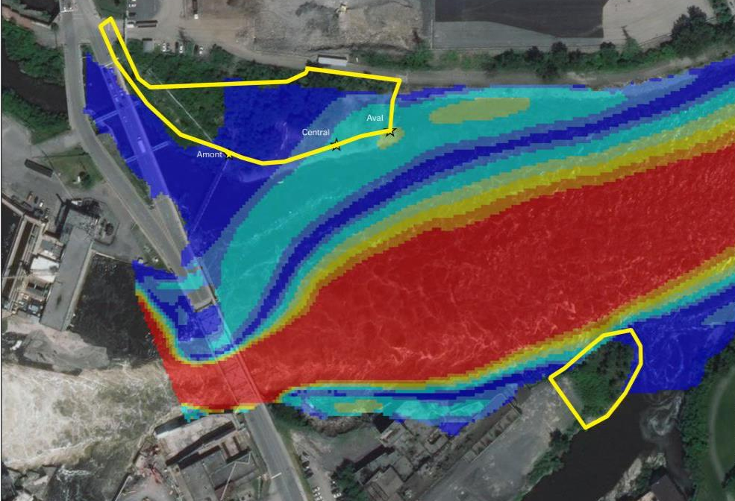
Spring 2019 - Flooding
Inondations du printemps 2019
Notes:
The dramatic Spring flooding in 2019 prompted a rethinking of the design of the park. With over 5700 cubic meters of water flowing through this section of river per second, large portions of the existing shoreline were scoured away.
The site of Tesasini Park was mostly submerged and lost significant amounts of soil and vegetation to the current.
Next slide

Slide 7
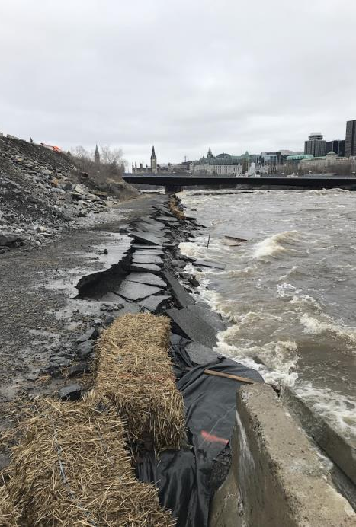
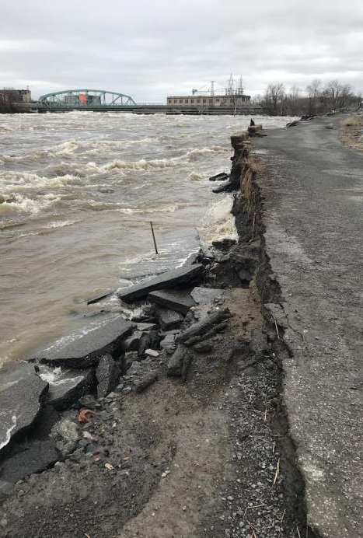
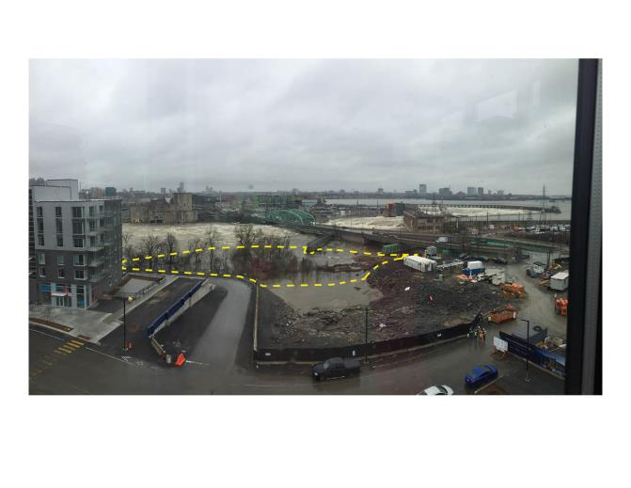
North Shore – 2019 Flooding
Berge nord – inondations de 2019
Notes:
These photos show the damage along the north shore of the river. You can see that the existing roadway, that was to be used as segregated cycling and pedestrian paths connecting to the Voyageur pathway network, was undermined and fell into the river.
On the top right you can see that the future Tesasini park site is submerged.
Next slide

Slide 8
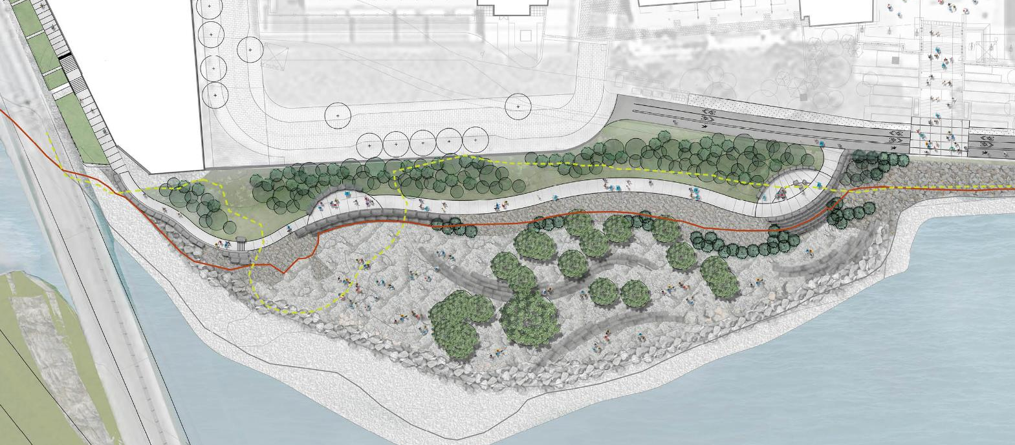
Tesasini Park - 2021
Parc Tesasini - 2021
Section 1
Section 2
Section 3
Notes:
In light of the damage that was done and the increased likelihood of future similar events in the context of climate change, the design direction of the park shifted to be more resilient.
The revised design of Tesasini Park is for a dramatic landscape that will feature exposed bedrock shelves and an armored ground plane to increase resiliency. Additionally, the intent is to preserve the existing mature trees in situ as they contribute to stabilizing the shoreline.
The majority of the area will feature only informal access when the water levels are low and includes a UA pathway above the 100-year flood plain with two lookout rest stops which will be accessible year-round. A belt of new native planting will be installed north of the pathway, providing a green buffer between the Zibi development and the shoreline.

Slide 9
Sections
100 year 100 ans
Section 1
100 year 100 ans
Section 2
100 year 100 ans
9
Section 3
Notes:
Here are three sections through the park showing the pathway located safely above the 100 year flood line, the existing mature trees and the rocky landscape. A new belt of planting is shown to the left of the sections, adjacent to the Zibi development.
Flood resiliency has also been increased by incorporating some of the technical details that have proven successful in maintaining the shoreline from other recent NCC projects along the Ottawa River.
Next slide

Slide 10
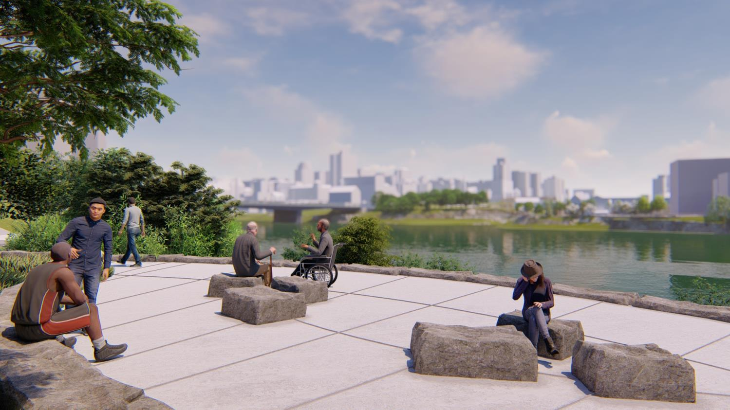
Notes:
Now I would like to share a selection of renderings which demonstrate aspects of the design.
This image shows one of the seating nodes, with large stone blocks serving as seating elements and the generous UA walkway just adjacent. Excellent views of downtown Ottawa will be available.
Next slide

Slide 11
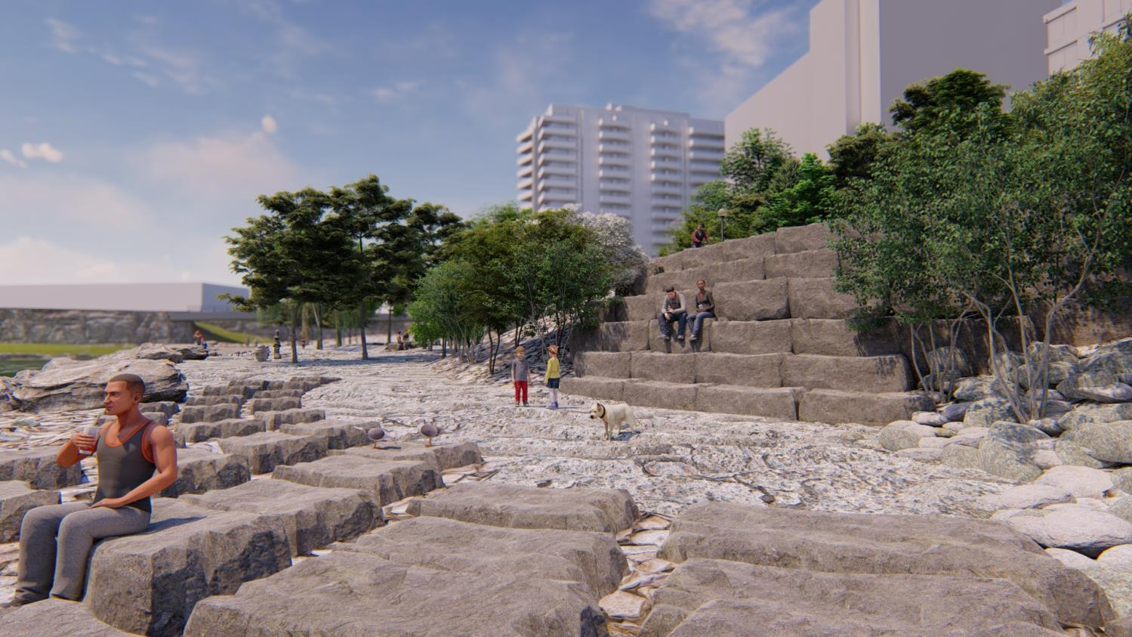
Notes:
This image is a view from near the shoreline of the informal rocky landscape looking back towards the Zibi development. Scattered armourstones serve as seats to enjoy being near the water.
The pathway shown in the last image is located at the top of the terraced armourstone.
Because the river’s current is so strong in this location, we want people to interact with the water but in a safe way.
Next slide

Slide 12
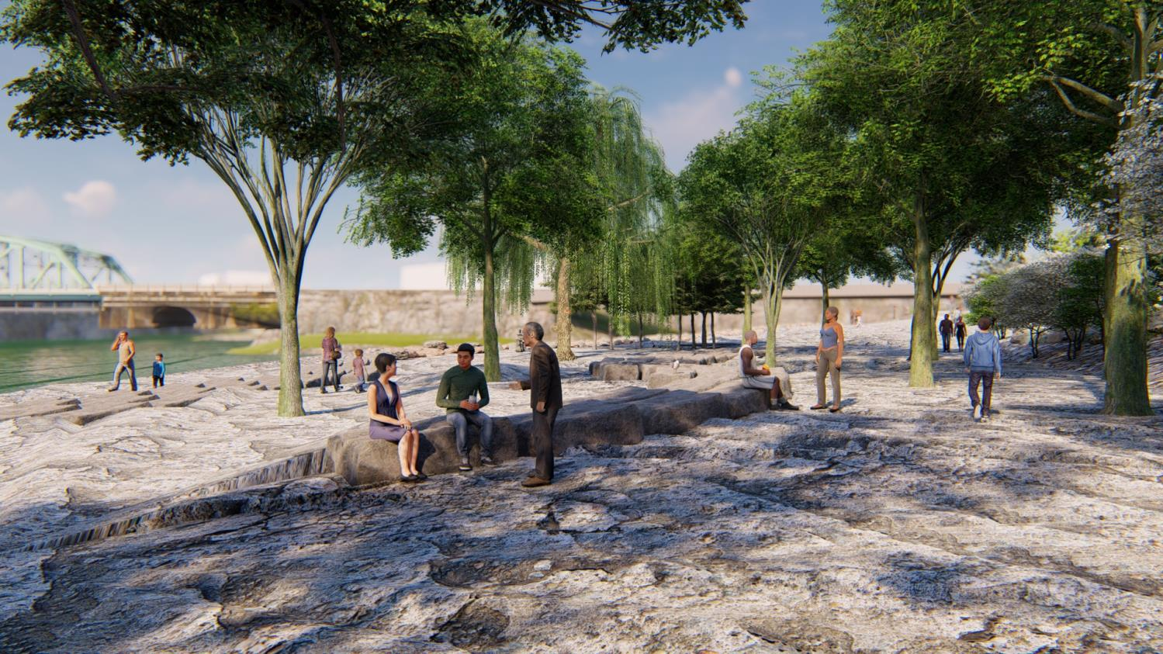
Notes:
This is an image of the landscape showing the mature trees that are proposed to be preserved. They will provide some welcome shade in what is admittedly exposed landscape.
Next slide

Slide 13
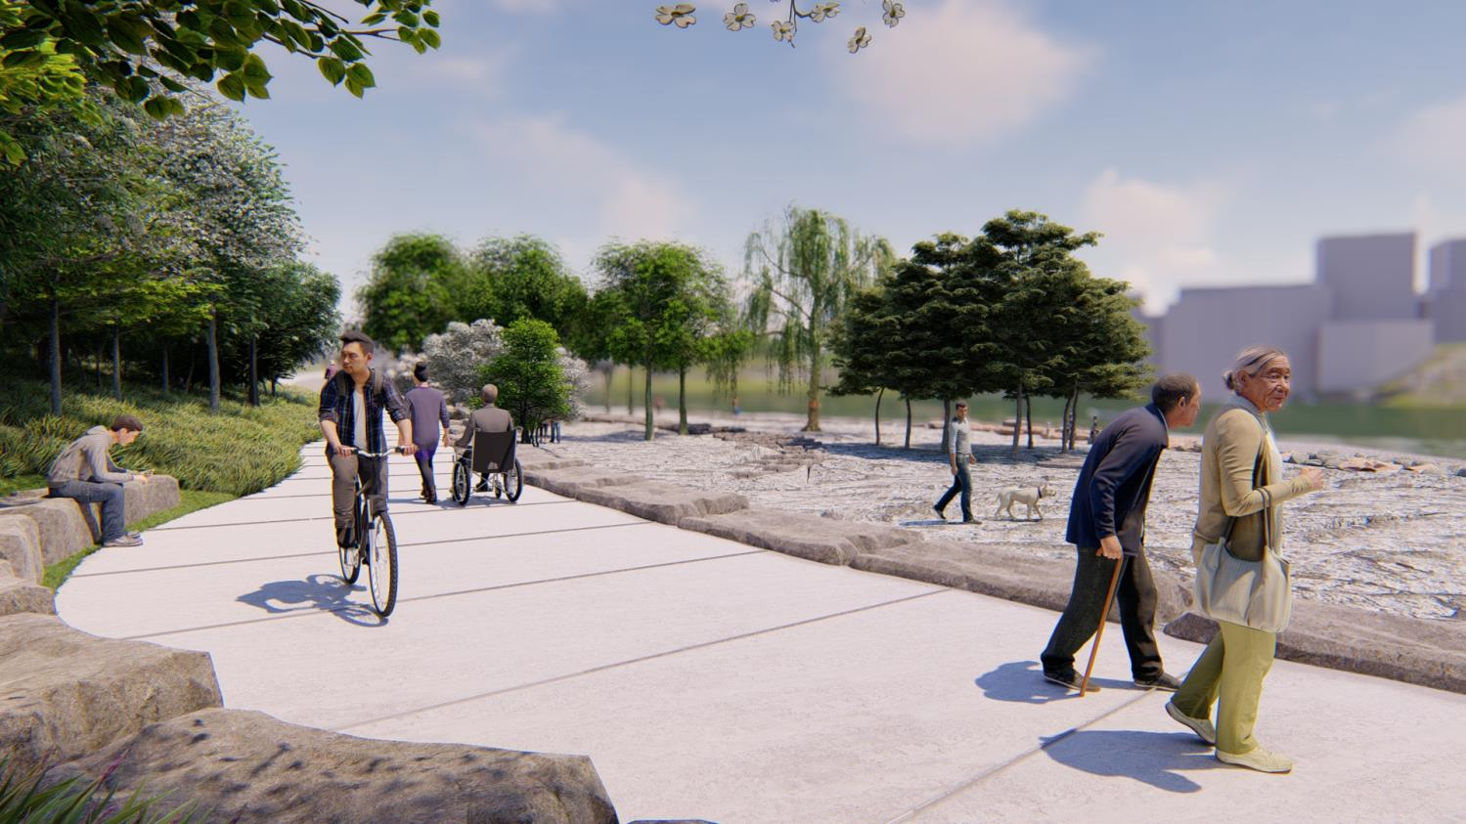
Notes:
This image shows a second smaller seating node along the western side of the pathway.
These nodes may also serve as sites for future interpretation and perhaps public art.
Next slide

Slide 14
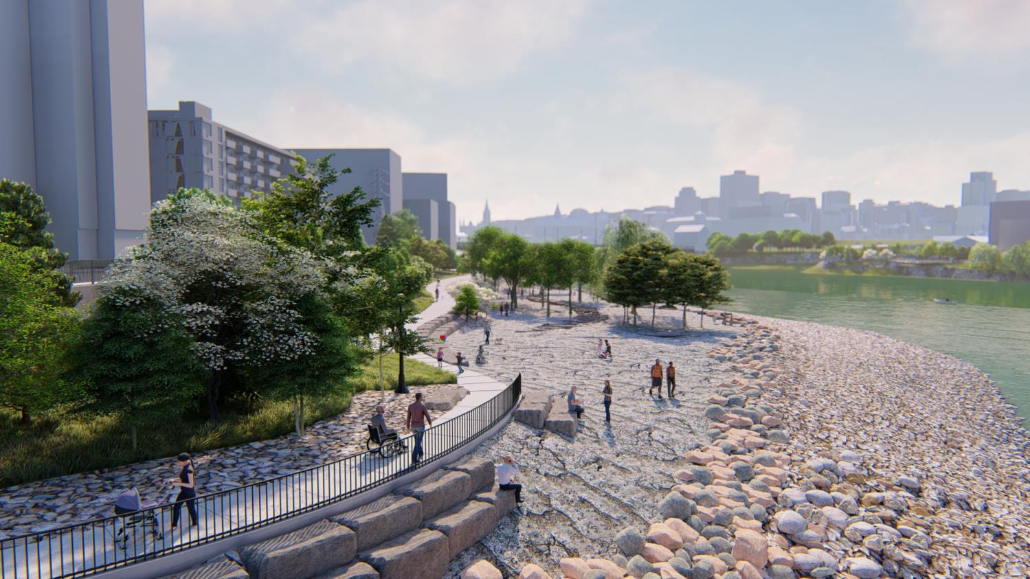
Notes:
This aerial view shows the majority of the park with the walkway, vegetation and rocky landscape. The rounded stone rip-rap to the right serves to discourage people from actually physically entering the water.
Next slide

Slide 15
ACPDR Comments
Commentaires du CCUDI
• The parks are distinct in character, and the rocks, especially in Tesasini make them
powerful spaces resilient to water.
• The level of floods should be planned for a longer horizon than the 100-year mark for increased resiliency.
• The parks should be even more connected to the river. Better access should be contemplated, recognizing the dilemma between creating resilient spaces and open access to the river.
• Les parcs ont des caractères distincts, et les roches, en particulier dans le parc Tesasini, en font des espaces puissants qui sont résilients à l’eau.
• Pour une plus grande résilience, on devrait prévoir un horizon à plus long terme que la limite des crues de 100 ans.
• Les parcs devraient être encore plus reliés à la rivière. On devrait envisager un meilleur accès, tout en reconnaissant le dilemme entre la création d’espaces résilients et l’accès libre à la rivière.
Notes:
When the revised park design was presented, along with the other two parks, to the ACPDR in February of 2020, it received strong support, especially for the incorporation of Algonquin themes and design features.
Their advice helped to focus staff on ensuring that above all, this park would go over and above to be resilient and to balance access to the river with this resiliency. The strategy we have pursued is to maximize visual access to the river with a wide open landscape that allows the rivers edge to approach and recede as the seasons turn and the years pass by.
Next slide

Slide 16
Next Steps
Prochaines étapes
• Begin construction of Tesasini Park in summer of 2021.
• Seek FLUDA from the NCC Board of Directors for the Developed Design of Mokaham park in winter of 2021/2022.
• Début des travaux de construction du parc Tesasini à l’été 2021.
• Présentation de la demande d’AFUSD pour la conception détaillée du parc Mokaham au conseil d’administration de la CCN, au cours de l’hiver 2021-2022.
Notes:
“Read slide”
Next slide

Slide 17
Recommendations
Recommandations
THAT the FLUDA for the Developed Design of Tesasini Park be granted, pursuant to Section 12 of the National Capital Act;
THAT minor design modifications arising from the construction procurement process be delegated to staff for resolution.
THAT the signature of the FLUDA document be delegated to the Vice President, Capital Planning Branch.
QUE soit accordée l’AFUSD pour la conception détaillée du parc Tesasini, conformément aux dispositions de l’article 12 de la Loi sur la capitale nationale;
QUE les modifications mineures de la conception découlant du processus d’approvisionnement en construction soient déléguées au personnel pour résolution;
QUE la signature du document de l’AFUSD soit déléguée à la vice-présidente, direction de l’Aménagement de la capitale.
Notes:
“Read slide”
Thank you for your attention. I would like to now turn it over for any questions or comments you might have.

Slide 18
DISCUSSION

