Slide 1
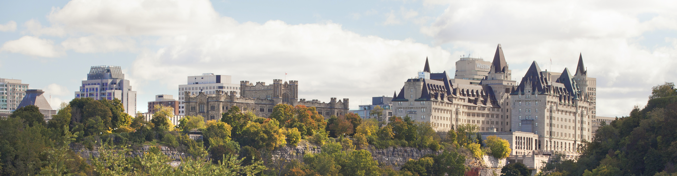
Fairmont Château Laurier
Landscape Integration
with NCC Lands
L’intégration du paysage
avec les terrains de la CCN
June 23, 2021
23 juin 2021
Notes:
Kalen:
Good morning everyone, today we are pleased to be presenting the concept design for the interface between the new Fairmont Château Laurier Hotel addition and the adjacent NCC lands.
The hotel addition project is located on private property, but it is surrounded by NCC lands on all sides. This project will exert a major influence over these federal lands, both during the construction process as well as through permanent interventions.
Because it is located on privately-owned lands, the architecture of the addition is not subject to Federal Approval. The NCC’s authority will cover the interface between the new building and the surrounding federal lands in terms of landscape and urban design improvements.
This project was presented to the ACPDR last February. Since then, the concept has been refined with the oversight of NCC staff working closely with the proponent and their consultants.
Just to note: further discussion on financial elements related to this project will be presented later this afternoon during the in-camera session.
I will now hand the presentation over to Kelly Wojnarski, Senior Landscape Architect with the Federal approvals team.
Kelly:
Good morning. Thank you, Kalen for the introduction.
The purpose of today’s presentation is to seek approval for the Concept Design of the interface between the new Château Laurier addition and the surrounding NCC lands. [NEXT]

Slide 2
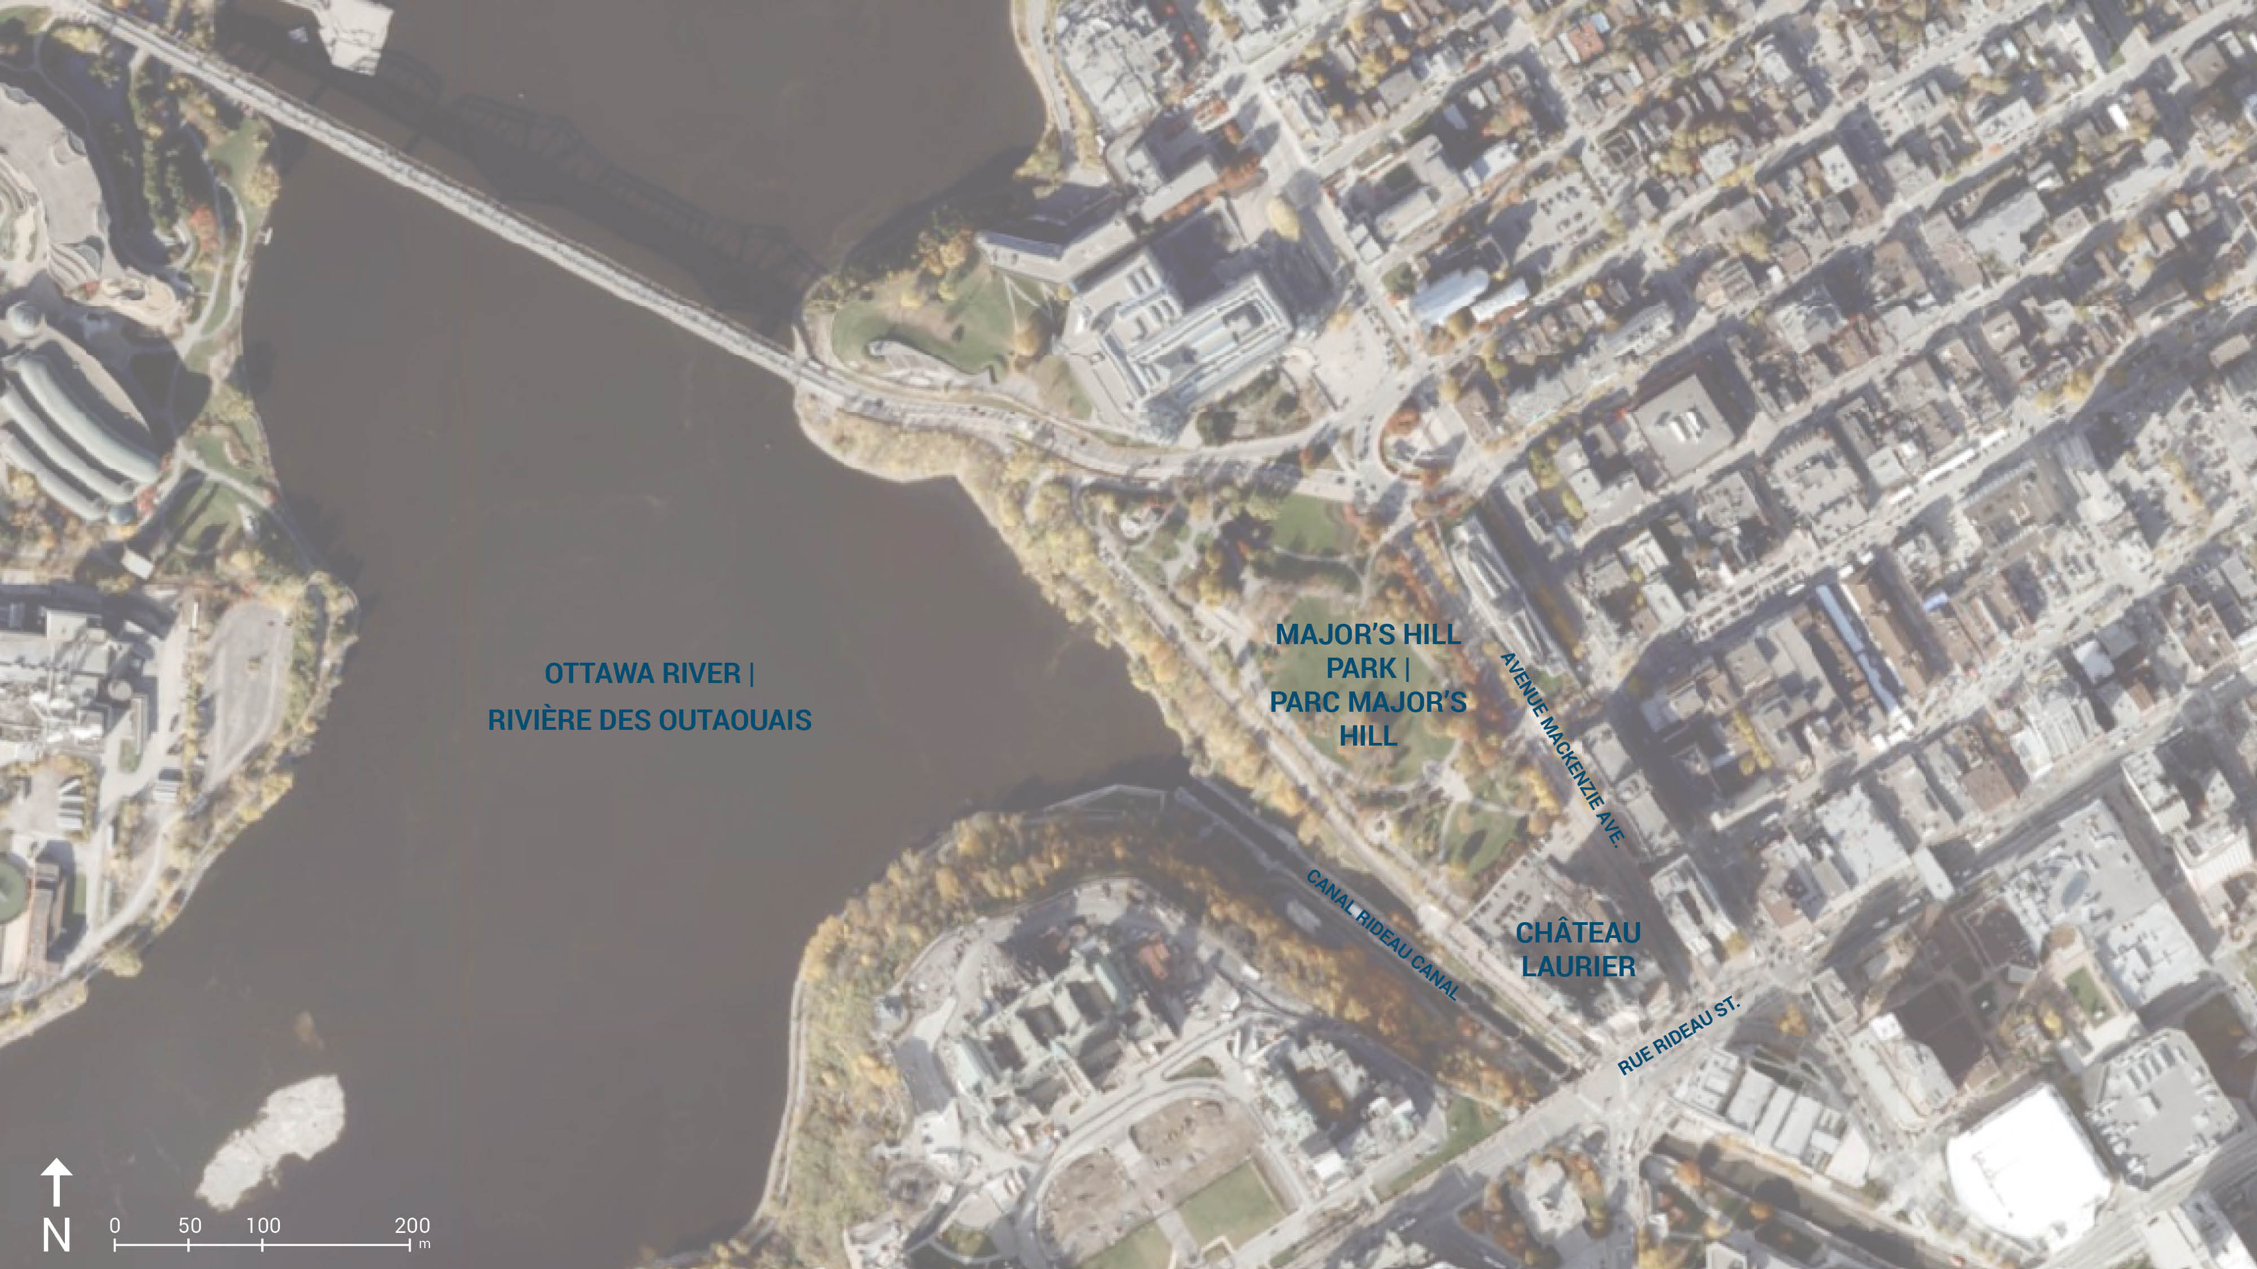
CONTEXT | CONTEXTE
2
Notes:
Located in the heart of downtown Ottawa, the Château Laurier occupies a prominent position in the Capital viewscape.
The new addition is to be constructed behind the existing hotel. As Kalen mentioned, this is private property, so it is not subject to NCC approval. The addition received the necessary municipal approvals earlier this year.
NCC design approval is being sought for the interface between the new addition and surrounding NCC lands to ensure optimum integration, coordination and design excellence.
Today’s presentation will focus on the concept design stage for the interfaces. Temporary construction impacts, including preparatory site works, are being managed as a separate Level 2 approval currently under review at staff level. [NEXT]

Slide 3
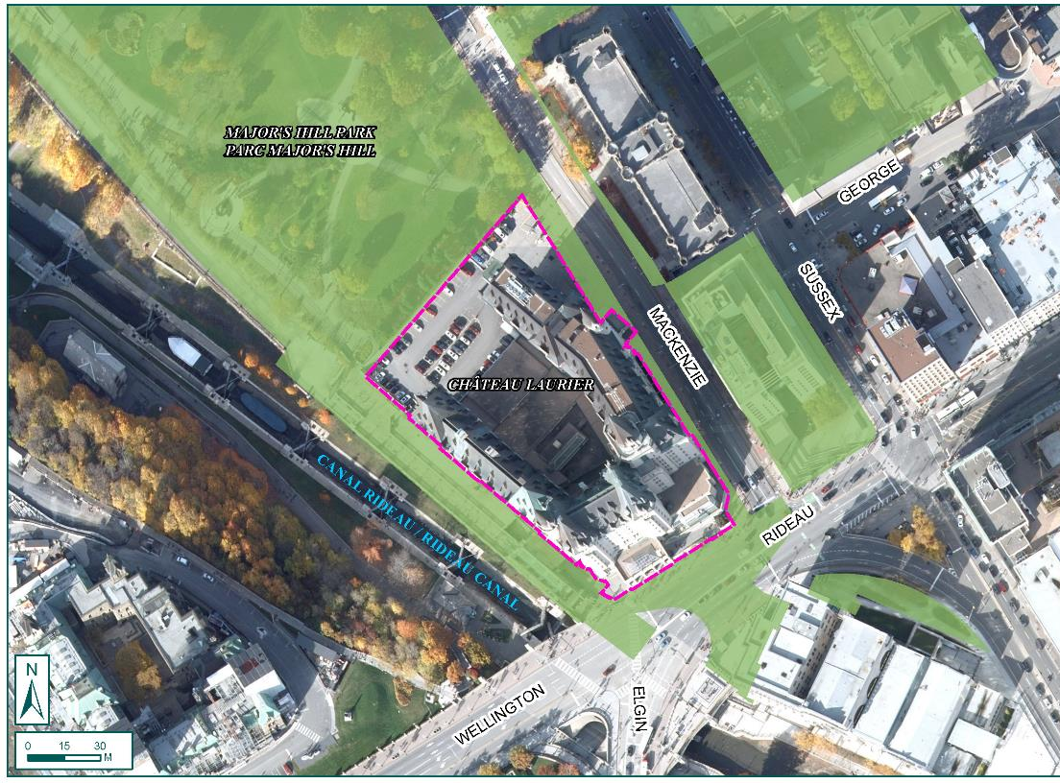
NCC LANDS | TERRAINS DE LA CCN
Legend | Légende
NCC Land | Terrain de la CCN
Château Laurier Property
Propriété du Château Laurier
3
Notes:
To elaborate on the land ownership, this map illustrates the NCC’s property in green which surrounds the hotel parcel on all four sides, including:
Major’s Hill Park on the north side
The Rideau Canal Upper and Lower Terraces on the west
Mackenzie Avenue to the east, and
Rideau Street on the south side.
Both Mackenzie and Rideau are part of Confederation Boulevard, the NCC’s ceremonial route.
The Château Laurier addition is one of several major projects under development within this vicinity, and it is seen as a great opportunity to leverage for a consistent, high-quality landscape experience in the adjacent NCC lands, especially Major’s Hill Park. [NEXT]

Slide 4
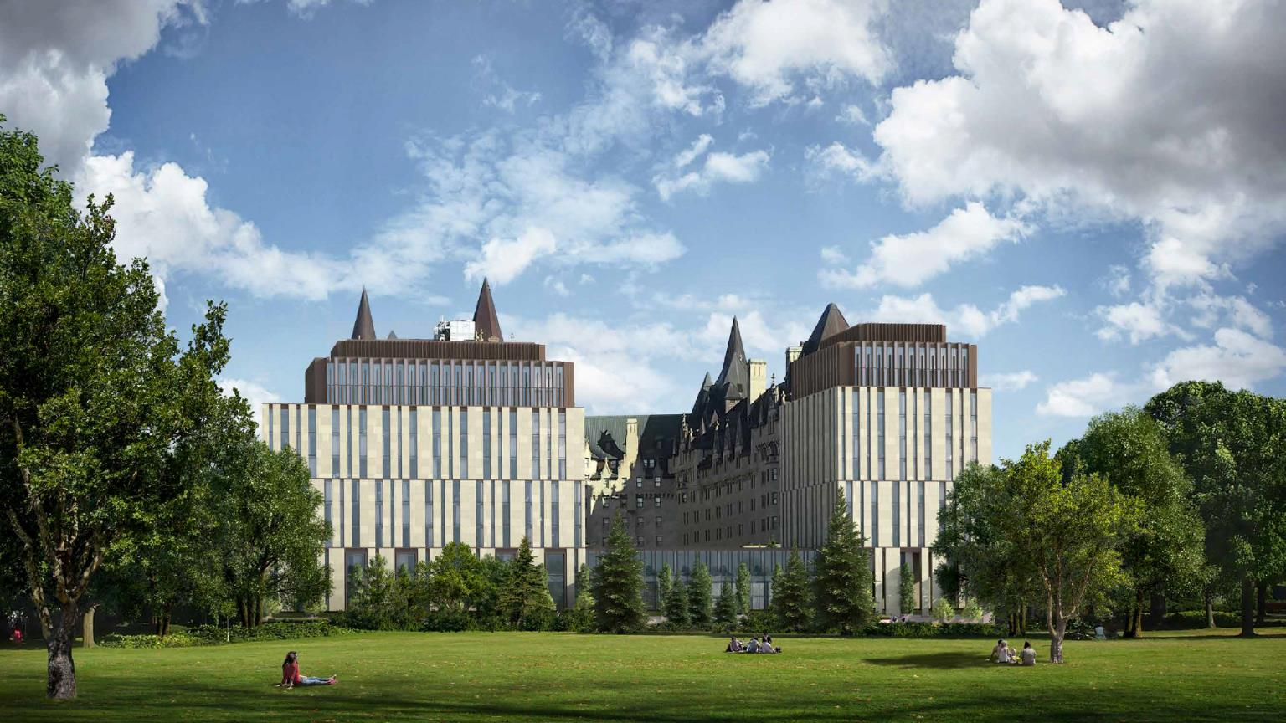
CHÂTEAU LAURIER ADDITION | ADDITION AU CHÂTEAU LAURIER
4
Notes:
This is the approved design for the Château Laurier’s new addition, which will feature an Eastern pavilion of 10 storeys, a Western pavilion of 11 storeys, and a two-story glass link in between.
The main floor will contain a lobby, meeting rooms and a proposed café/bistro at-grade.
To note: this rendering captures the architectural proposal, whereas the vision for the interface with the park will be illustrated later on in the presentation. [NEXT]

Slide 5
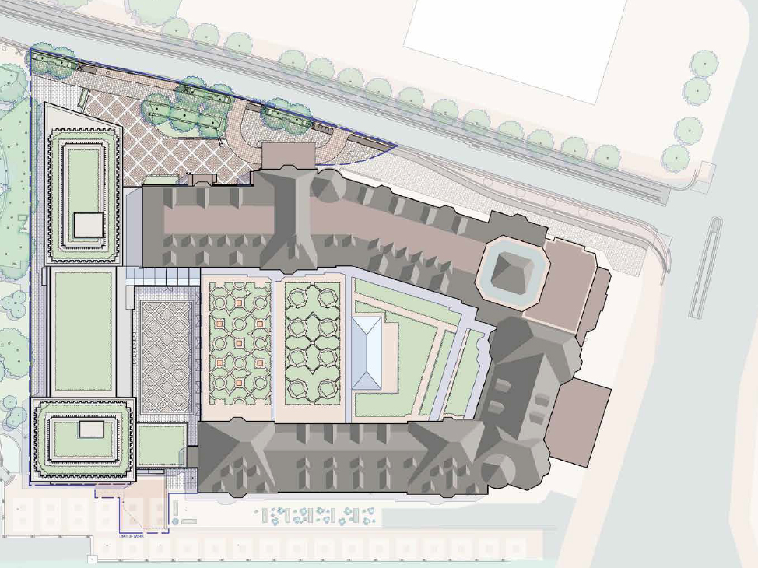
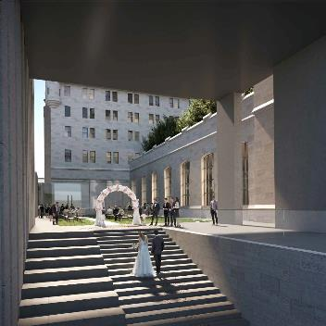
N
CHÂTEAU LAURIER PLAN | PLAN DU CHÂTEAU LAURIER
Mackenzie Avenue
avenue Mackenzie
rue Rideau
Rideau Street
0
5
10
25m
5
Notes:
The Proponent’s site plan contains several elements which establish an enhanced connectivity and improved landscape experience:
Firstly, a new inner courtyard is included between the hotel and addition – as shown by the orange star. This feature enhances the facility’s ballroom offerings and provide for a new grand staircase connecting down to the lower canal terrace (as seen in the top left image). This courtyard would be accessible to the public outside of private events.
Secondly, a transverse pathway – as shown by the red arrow - links Mackenzie to the Rideau Canal Terrace and provides improved connectivity in this area. Maintained by the Proponent, this pathway is to be open and publicly-accessible year round.
Thirdly, a new primary public entrance at the back of the addition (as seen in the bottom left image) will connect Major’s Hill Park to the public main floor of the hotel (via the ‘Adam Room’ Corridor) and beyond to Rideau Street – as shown by the dark blue arrow. [NEXT]

Slide 6
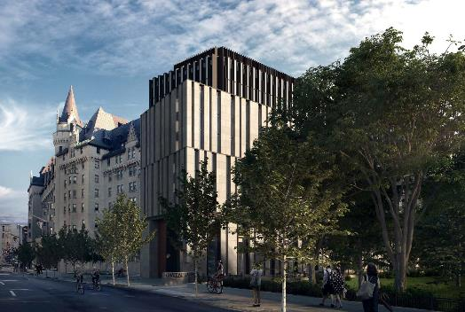
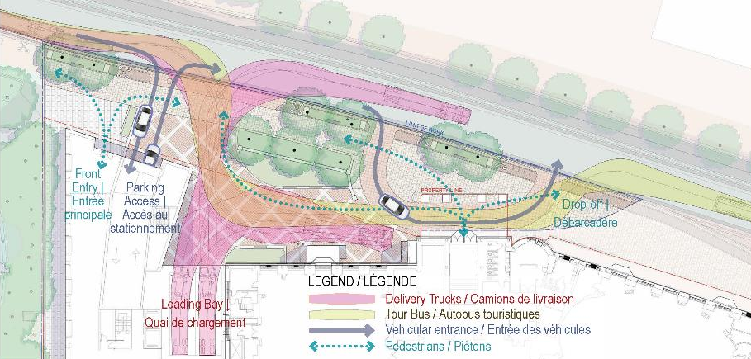
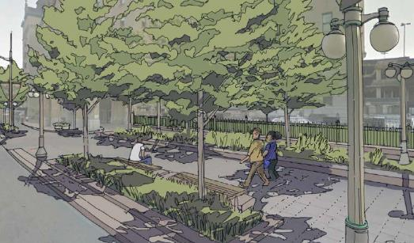
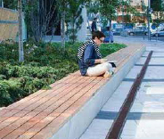
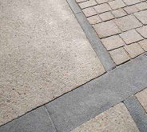
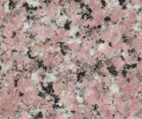
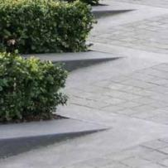
CONFEDERATION BOULEVARD | BOULEVARD DE LA CONFÉDÉRATION
N
Mackenzie Avenue
avenue Mackenzie
0
5
15m
6
Notes:
Furthermore, urban design improvements to Mackenzie Avenue are incorporated in this project.
This includes a new forecourt with loading dock/bus drop-off area which features the Confederation Boulevard design standards and palette of materials.
Seating and plantings, including street trees, will continue the language of this ceremonial boulevard and help extend the greenery of Major’s Hill Park along the streetscape. [NEXT]

Slide 7
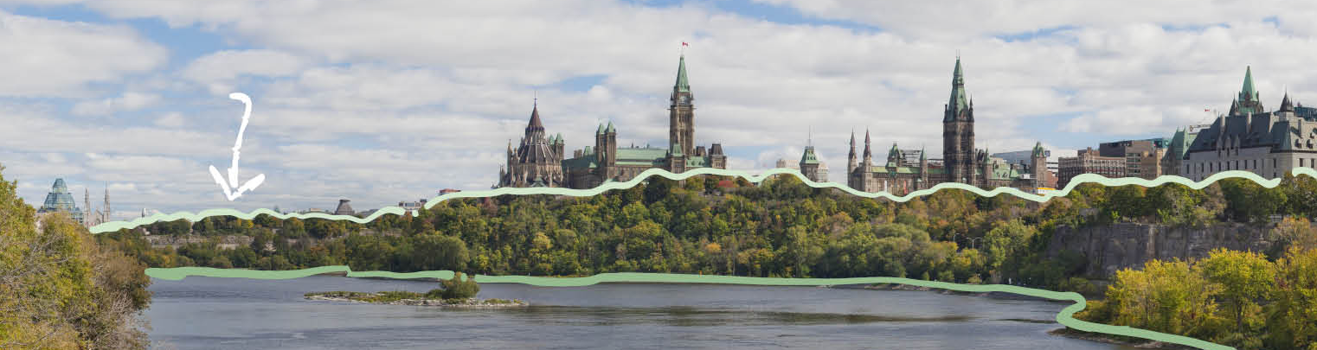
Major’s Hill Park Vision
Vision du parc Major’s Hill
Picturesque legacy
Riverfront landscape
Authentic character
Héritage pittoresque
Paysage riverain
Caractère authentique
Notes:
The south interface of the site is particularly crucial for the NCC because it sits adjacent to Major’s Hill Park, one of Ottawa’s oldest and most significant urban greenspaces.
While the park will be addressed in the Core Area Sector Plan update as well as an upcoming Masterplan, review of the south interface has advanced more quickly to accommodate project timelines and to leverage the current opportunity for a more seamless integration between these two iconic sites – that is, to enhance the new frontage without compromising the welcoming and public character of the park.
NCC Staff have overseen the design process, organizing workshops with a focus on connectivity, UA, lighting and protected views.
Three design directions prepared by the NCC have guided this process:
To renew the park’s Picturesque design legacy
To enhance the riverfront landscape as a green setting for Capital institutions, and
To reinforce the unique and rugged character of our Capital landscape. [NEXT]

Slide 8
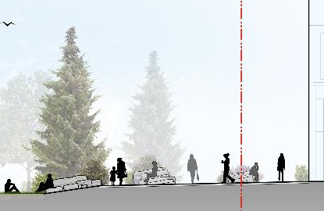
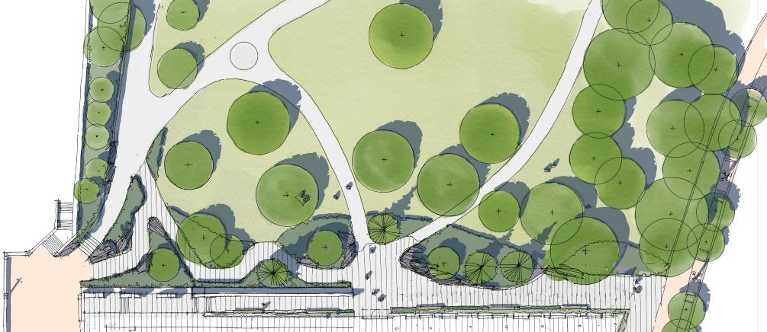
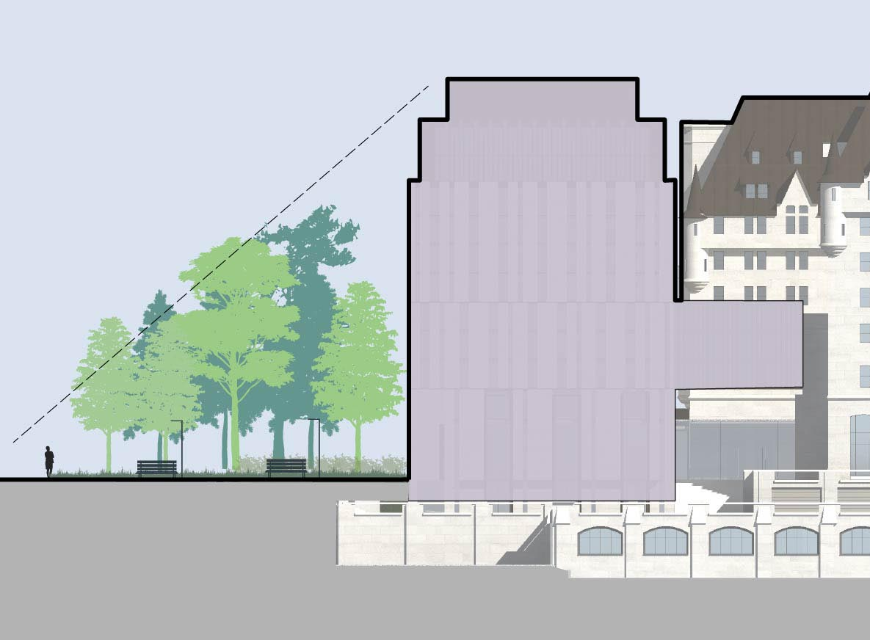
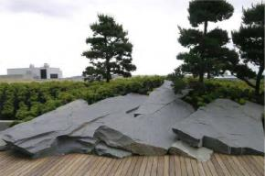
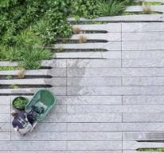
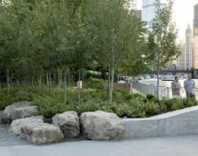
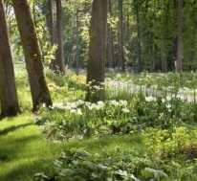
MAJOR’S HILL PARK CONCEPT | CONCEPT DU PARC MAJOR’S HILL
0
5
15m
Section A | Coupe A
Section A | Coupe A
N
Property Line | Limite foncière
8
Notes:
Here is the concept for the Major’s Hill Park interface. In it, the addition is treated as a pavilion in the park, but the park comes first.
The transverse pathway is extended from 3m, to a width of up to 7m for more generous circulation space and articulate the connection point with the pathway into the park, which is a flush UA connection leading right into the new hotel entrance, as shown in the section on the upper right. These pathways and entrance will be open year round during the park’s hours of operation.
The grade change between the two sites will be accommodated by rockery (which recalls the park escarpment) and retaining walls (which references the hotel architecture)
A loose boundary is created by seating walls, columns, steps, planters and plantings which provide a pleasant and welcoming threshold between public and semi-public spaces.
Enhanced tree canopy in the park frames the addition as well as views outwards, and buffers between the verticality of the new building and the horizontality of the central lawn, as illustrated in the section on the bottom left of the slide. [NEXT]

Slide 9
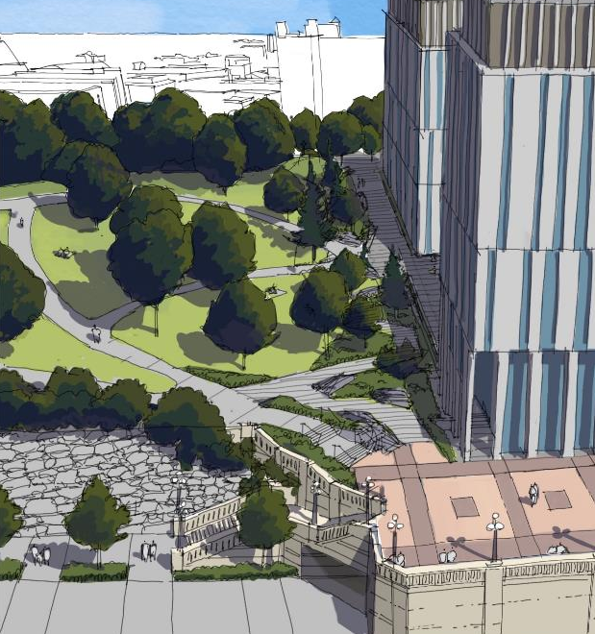
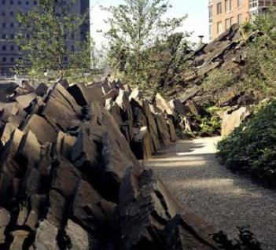
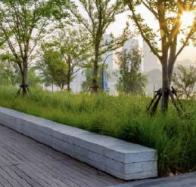
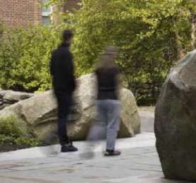
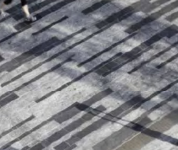
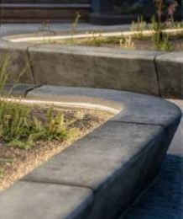
RIDEAU CANAL TERRACE ENTRANCE | ENTRÉE DE LA TERRASSE DU CANAL RIDEAU
9
Notes:
A grander entrance into park is proposed from the Rideau Canal Terrace.
This features an expansion to include a new accessible sloped pathway into the park, with a gentle gradient of about 3% and is a major improvement to the current pinch point at this corner.
This element picks up on the park’s design language of the rough, vegetated escarpment, and flows down gently and elegantly to meet the terrace.
A potential future connection down to Pioneers Road in accounted for, and could form part of a future phase of the park’s development.
To complete this accessible link into the park, the NCC in currently in talks with PSPC to improve accessibility down from Rideau Street.
All of the interventions proposed today will incorporate high quality materials and finishes, and subtle, context-sensitive lighting.
This will be to be managed in the subsequent Level 2 approval for detailed design to ensure consistency with initial vision and NCC standards. [NEXT]

Slide 10
ACPDR –
Comment Resolution
Résolution des commentaires – CCUDI
Soutien du CCUDI pour la connexion proposée
Éléments clés signalés et traités :
    Le connectivité et l’accès
    La médiation des styles paysagers
    La voie transversale
    La végétation
    Le traitement de l’avenue Mackenzie
ACPDR support for proposed connection
Key elements flagged and addressed:
    Connectivity and access
    Mediation of landscape styles
    Transverse pathway
    Vegetation
    Mackenzie Ave treatment
Notes:
As Kalen mentioned, this project was presented at the ACPDR on February 25th.
The committee supported the proposed connection between the park and the hotel, and the back entrance, but advised Staff to seek clarification on access and the gradient of public to private spaces which was addressed in the concept presented today.
Several other key items were raised and which have been addressed:
Detail was sought on connectivity and Universal Accessibility from Rideau Street via the Canal Terraces. These have been addressed within the plan through the reconfigured southwest park entrance (sloped pathway) as well as NCC discussions with PSPC regarding public access to the elevators at 1 Wellington.
The mediation between the discrete landscape styles of the park and the hotel was another item which required further review. The concept design of the interface picks up on design elements of the park (rugged escarpment and rockery, curving geometry, and mature canopy trees) and blends it with the more formal features of the addition (rectilinear architecture, geometric paving, and flat parterre). The resulting proposal suggests a blending of the two styles but an overall predominance of the park.
The transverse pathway was also revisited – this element was widened from 3m to a varying width of up to 7m to provide a more generous circulation experience.
Specific comments on vegetation (existing and proposed) and the Mackenzie Ave treatment (paving maintenance/durability) were noted and addressed in the concept plan, and the ancillary Level 2 approval on preparatory site works, as well as the forthcoming Level 2 approval on the Detailed Design. [NEXT]

Slide 11
Next Steps
Prochaines étapes
Spring / Summer 2021
Application for Level 2 FLUDTA: Preparatory site works/servicing
Fall 2021
Targeted onset of works – addition
Targeted presentation of Major’s Hill Park Masterplan to ACPDR
Application for Level 2 FLUDTA: Detailed design of interface
Fall 2024
Anticipated construction completion
Printemps / été 2021
Demande d’AFUSDT niveau 2 : travaux préparatoires et services publics
Automne 2021
Début ciblé des travaux - addition
Présentation ciblée du plan directeur du parc Major's Hill au CCUDI
Demande d’AFUSDT niveau 2 : conception détaillée de l'interface
Automne 2021
Achèvement prévu des travaux
Notes:
The concurrent Level 2 application for preparatory site works – including hoarding, staging and below-grade servicing - is currently under review at Staff-level and will be advancing for e-vote in the coming weeks.
The onset of these works is planned for this Fall.
During this time, design work would advance with the MHP masterplan targeting an ACPDR presentation in late Fall with the detailed design for the interface finalized for the Level 2 approval
Works would progress on the addition and surrounding lands, looking ahead to completion of the project in 2024. [NEXT]

Slide 12
FLUDTA
RECOMMENDATIONS
THAT the Federal Design Approval for the Concept Design of the interface between the proposed Fairmont Château Laurier Hotel addition with the surrounding NCC lands be granted, pursuant to Section 12 of the National Capital Act, subject to;
      a) The final Developed Design being presented for NCC review and approval as a separate Level 2 project; and
THAT the signature of the Federal Design Approval documents be delegated to the Vice-President, Capital Planning Branch.
Notes:
To summarize, we are seeking approval on the Concept Design of the interface between the proposed Château Laurier addition and the surrounding NCC lands. [NEXT]

Slide 13
AFUSDTI
RECOMMENDATION
QUE soit accordée l’approbation fédérale du design conceptual de l’interface entre l’annexe de l’hôtel Fairmont Château Laurier proposée et les terrains fédéraux de la CCN avoisinants, en vertu des dispositions de l’article 12 de la Loi sur la capitale nationale, sous reserve de ce qui suit :
a) Le design détaillé final doit être présenté à la CCN aux fins d’examen et approbation à titre de projet de niveau 2 distinct.
QUE la signature des documents d’approbation fédérale de design soit déléguée à la vice-présidente, Direction de l’aménagement de la capitale.
Notes:
Et voici la recommandation en français [NEXT]

Slide 14
Notes:
Thank you for your time – that concludes today’s presentation.

Slide 15
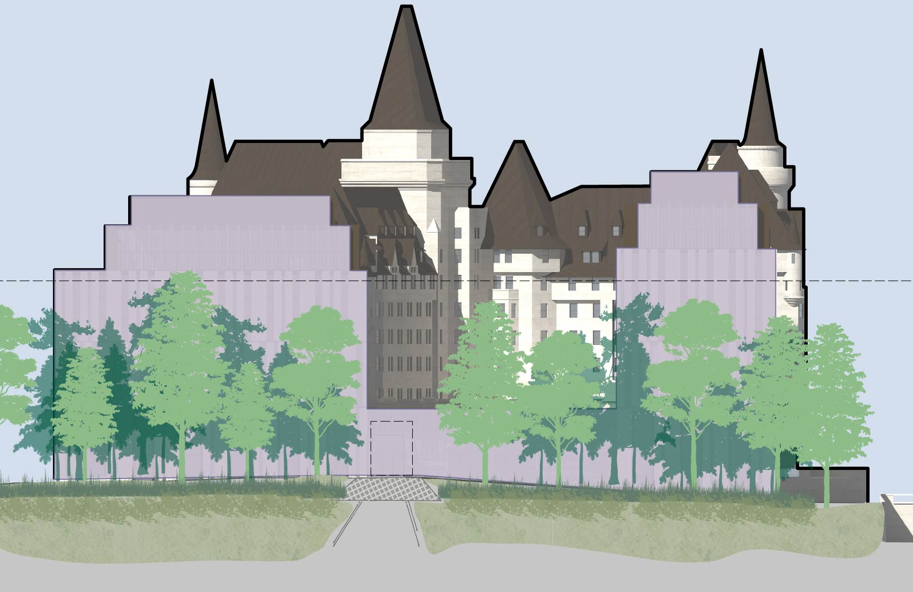
MAJOR’S HILL PARK CONCEPT | CONCEPT DU PARC MAJOR’S HILL
0
5
15m
Section A | Coupe A
Section A | Coupe A
N
Property Line | Limite foncière
Notes:
Here is the concept for the Major’s Hill Park interface. In it, the addition is treated as a pavilion in the park, but the park comes first.
The transverse pathway is extended from 3m, to a width of up to 7m for more generous circulation space and articulate the connection point with the pathway into the park, which is a flush UA connection leading right into the new hotel entrance, as shown in the section on the upper right. These pathways and entrance will be open year round during the park’s hours of operation.
The grade change between the two sites will be accommodated by rockery (which recalls the park escarpment) and retaining walls (which references the hotel architecture)
A loose boundary is created by seating walls, columns, steps, planters and plantings which provide a pleasant and welcoming threshold between public and semi-public spaces.
Enhanced tree canopy in the park frames the addition as well as views outwards, and buffers between the verticality of the new building and the horizontality of the central lawn, as illustrated in the section on the bottom left of the slide. [NEXT]

